Slide 1



VFW Multi-Factor Authentication

Slide 2


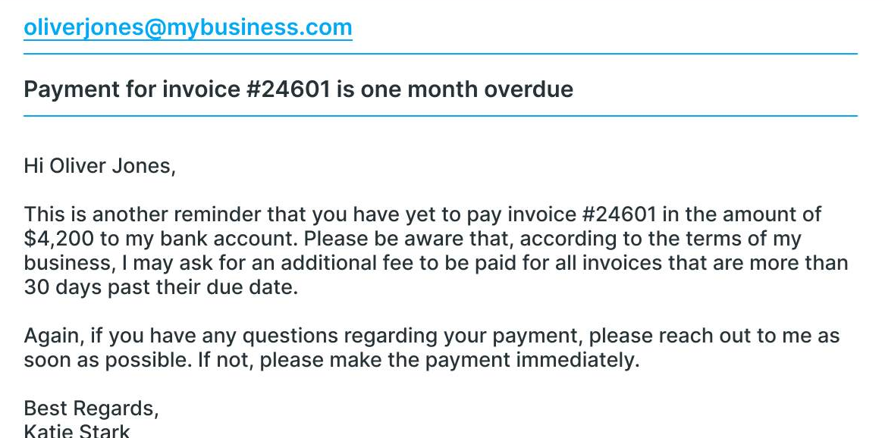
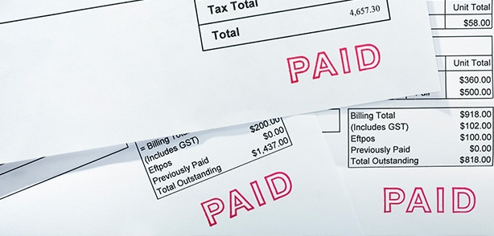
Why use Mult-Factor Authentication?

Slide 3
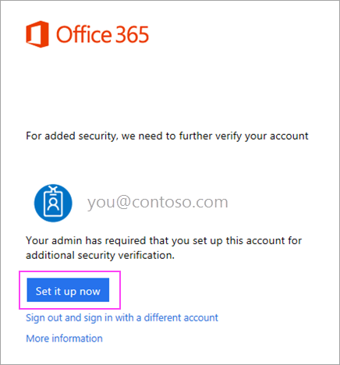
Registering Your Device with Microsoft Authenticator
Download and install Microsoft Authenticator on your mobile device from the Google or Apple store.
On your computer, go to portal.office.com and log in.
After logging in, you will see this prompt
Click Set it up now.
Choose Mobile App from the drop down.
Make sure “Receive notifications for verifications” is selected.

Slide 4
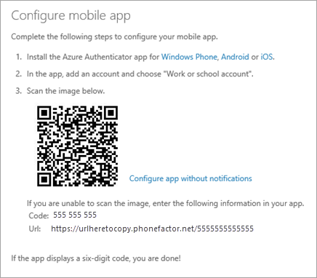
Registering Your Device with Microsoft Authenticator
Wait for the configuration pop-up box.
You should see a window that looks like this
Open the Authenticator app on your phone.
Tap + > Work or school account.
Use your phone to scan the QR code on your computer screen. iPhone users may have to enable the camera in settings in order to scan. If you can’t use your phone camera, you will have to manually enter the nine-digit code and the URL.
Your account will be automatically added to the app and will display a six-digit code.

Slide 5
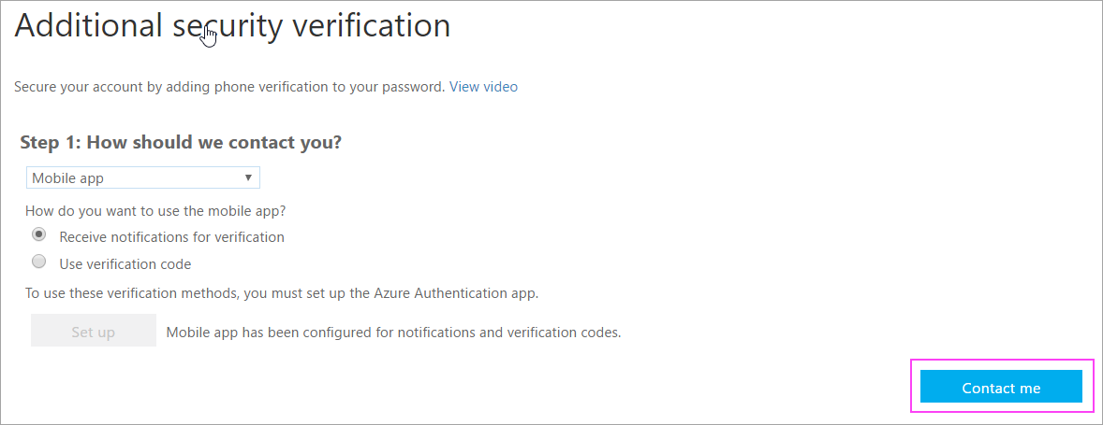
Registering Your Device with Microsoft Authenticator
Switch back to your computer and click Done.
Now wait for the Checking Activation status text to finish configuring your phone.
When it is complete, you will be able to click the Contact Me button on the right.
If configuration fails, just delete and retry the previous steps.

Slide 6
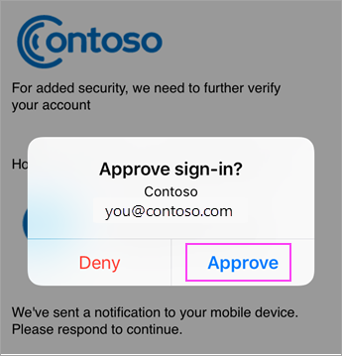
Registering Your Device with Microsoft Authenticator
Switch back to your phone and you will see a notification for a new sign-in.
Go to the Microsoft Authenticator ap.
Tap Approve to allow it.
Back on the computer, follow any prompts that you might see such as adding a mobile number if you have another one you want to use.
From now on, whenever you have a new sign in, you will open the authenticator app on your phone and tap approve.

Slide 7
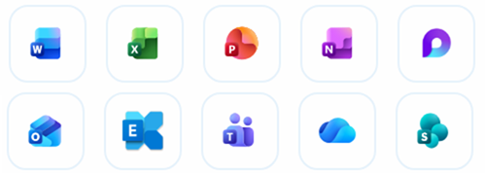
E1 Licensing Applications
These applications are available with the E1 License for $40 per user / per year
Web and Mobile versions of:
Word
Excel
PowerPoint
Outlook
Plus:
Teams
OneDrive
SharePoint
Planner
Forms
To Do
Lists
OneNote
Loop
Exchange Email

Slide 8
Implementation Rollout Dates
District Commanders & State Officers: Jan 9, 2026 @ 2:30 PM

Slide 9
Thank You!

