Slide 1
Virgina
Recruiting SOI 2021-2022

Slide 2
Video: Student Veterans

Slide 3
Our Mission
To foster camaraderie among United States veterans of overseas conflicts. To serve our veterans, the military, and our communities. To advocate on behalf of all veterans.

Slide 4
Our Vision
Ensure that veterans are respected for their service, always receive their earned entitlements, and are recognized for the sacrifices they and their loved ones have made on behalf of this great country.

Slide 5
Our Core Values
Always put the interests of our members first
Treat donors as partners in our cause
Promote patriotism
Honor military service
Ensure the care of veterans and their families
Serve our communities
Promote a positive image of veterans
Respect the diversity of veteran opinions

Slide 6
Membership Program
Look at the VFW National Membership program, and align Post/District/State goals to that program.
Identify the needs of your Post/District/State (i.e. State to increase life memberships, new members, or retention)
Ensure that each goal in your membership program is attainable and trackable.

Slide 7
Membership Program
Be specific about what your goals are
Make those goals measurable
Goals that you set must be attainable
Ensure that the goals are RELEVANT to the problem
Open ended goals are lazy, make them TIME-BOUND

Slide 8
Membership Program
Decide where you want to be on June 30, 2022 and divide that across all 12 months of the year (starting July 1, 2021). Set benchmarks, remember your life members are a huge number of members that help your statistics, create your team, and write your plan on paper.
Update your plan monthly. Talk about the plan at every Post/District meeting. Don’t be afraid to make needed changes to the plan if the change is needed to ensure success. Ask for help. Get training and materials. Achieve your goal.
“Take the ideas out of your head and write them on paper. That’s when they become a plan.”

Slide 9
Long-Term Planning
Make a plan to “forward-think” past today to solve potential challenges early.
Create an action plan - not just a “plan” – what are the specific actions which must be taken to achieve success?
Delegate short-term goals when appropriate.

Slide 10
Long-Term Planning
Communicate the plan effectively & often. Pro-Tip: Check for understanding.
Execute the Plan and move forward, analyze the results and adjust plan if needed.
Lessons Learned: take time at the end of the project to note what went well and what did not so the next project runs better.

Slide 11
Where Virginia Stands in Membership Now

Slide 12
Where Virginia Stands
Virginia is:
One of 52 departments
We have 13 districts
We have 130 posts
We serve in every community in the state

Slide 13
Where Virginia Stands
Virginia has about 720,000 veterans
If 10% are VFW eligible, we could have 72,000 members.
We only have 32,624 members as of this year.

Slide 14
Fundamentals of membership
The 3 R’s of membership
Retain current members
Reinstate former members
Recruit new members

Slide 15
Fundamentals of membership (Cont.)
Retaining current annual members
Email
Phone Calls
Note in the newsletter
Knock on their door
Mail them a letter
Engage on social media
Scan your followers for lapsed members

Slide 16
Fundamentals of membership (Cont.)
Reinstate former members (lapsed at least 2 years)
Similar to Renewing members, but a much larger pool to work with.
This could include unpaid At-Large members, members who moved here from other states, etc.

Slide 17
Fundamentals of membership (Cont.)
The 3 R’s put into perspective
Retain over 7,200 annual members
We will likely keep about 70% of this amount (plus 24,600 life members)
Reinstate as many as 9,200 unpaid members
We have the phone number/address for many of this number
Recruit new members to fill the gap
**NEVER say there is no one to recruit**

Slide 18
Break for 10 minutes

Slide 19
The Art of Recruiting

Slide 20
The Art of Recruiting (Cont.)
Step 1: Planning the Event

Slide 21
The Art of Recruiting (Cont.)
The Factors to Consider for Recruiting:
When (Weekend vs. Weekday)
Where (The actual store/location)
Weather (Are we inside or outside?)

Slide 22
The Art of Recruiting (Cont.)
Who should work the event?
At least one person is the “recruiter”
People training to be recruiters
Other members show the face of the post and attract people similar to them
But...not too many (2-3 people per table)
Auxiliary can help also!

Slide 23
The Art of Recruiting (Cont.)
What should you put on the recruiting table?
VFW Talking Points, Action Corps Weekly, Magazine
Post information (newsletter, etc.)
Generic brochures
Unpaid membership roster
APPLICATIONS!!!
Roster of Posts
Eligibility requirements

Slide 24
Example 1 of how this actually works
You are planning your event. Knowing what we recommend to put on your table and who to bring, how do you relate to all of this information?

Slide 25
The Art of Recruiting (Cont.)
Step 2: Recruiting the veteran

Slide 26
The Art of Recruiting (Cont.)
Tips of the trade
Read the person and identify the Veteran
Ballcaps, bumper stickers, shirts, boots
The 8 words to greet a veteran
“Are you a veteran? Where did you serve?”
Formal vs. Informal recruiting
We are always recruiters

Slide 27
The Art of Recruiting (Cont.)
Tips of the trade (Cont.)
Tell your story: In the military and VFW
There is the purpose of the VFW but also what makes it personal for you
The things people say: questions, comments and concerns
Don’t get sidetracked
Bring it back to closing the deal

Slide 28
The Art of Recruiting (Cont.)
Step 3: Close the Deal and Complete the Application

Slide 29
The Art of Recruiting (Cont.)
Personal information
Needs to be fully completed
Get a good email and phone number (helps with the Action Corps sign-ups)
Try to get a physical address, not just a P.O. Box
We DO NOT need the social security number

Slide 30
The Art of Recruiting (Cont.)
Military information
Military information needs to be aligned with VFW eligibility requirements
Get the dates of service (month and year)
Medal, ribbon, badge, pay, etc. that makes them eligible
Geographic location (major ocean for SSBN Sailors)

Slide 31
The Art of Recruiting (Cont.)
Type of membership, payment, Post to join
Life membership payment
In full (Debit, Credit, Cash, Check)
Payment plan
12 months, no invoices mailed, no cash
THEY MUST HAVE DEBIT/CREDIT CARD AND EMAIL ADDRESS WHEN YOU RECRUIT THEM
Annual membership
The Post they want to join
The one closest to them, your Post, or the At-Large Post (Post 15048)

Slide 32
The Art of Recruiting (Cont.)
Recruiter credit, former member number, signatures, and the stub
List your name and member number for recruiter credit
If a former member with their card, get the number
Possibly two signatures
All sign on the back
Those with a credit/debit card sign the end
Complete the stub and give it as their receipt and temporary membership card

Slide 33
The Art of Recruiting (Cont.)
Transferring and reinstated members
Complete the application mostly the same
No payments for Life Member transfers
If an annual member or expired pitch life membership
If they stay annual, get a payment if they expire before June 30th 2022 so you do not have to chase them down again.
If reinstated, get your member number on it for credit
No recruiter credit for transferring members
Complete the portion on the back about transferring
Have them sign

Slide 34
The Art of Recruiting (Cont.)
Current member who just wants to renew in a Post in Virginia but NOT transfer.
Complete the application just the same as a new member
Get their member number if they have their card
Pitch life membership
Get a payment (check your roster to ensure amount)
No recruiter credit for transferring members
Have them sign
Send it to the Post they belong to or State HQs for us to verify the membership and process

Slide 35
The Art of Recruiting (Cont.)
Step 4: Follow-up with the new member

Slide 36
The Art of Recruiting (Cont.)
Make them feel welcomed and wanted
Call/email/send a letter to the person welcoming them and invite them to the meeting
Arrange a carpool if needed
The National “Welcome Aboard” package
The National “Welcome Aboard” email
Introduce their spouses to the Auxiliary

Slide 37
Break for 10 minutes

Slide 38
Example 2 of how this actually works
You have heard a lot today. What is something new you learned? What is something you do when recruiting that helps get new members?

Slide 39
Video: Lifetime Membership

Slide 40
Additional tools and information

Slide 41
Additional Tools and Information (Cont.)
The QM Tools (OMS) Information
Your Post QM can pull unpaid and those soon to expire for your own Post
Host a small group at the Post and call members
It works!!!

Slide 42
Additional Tools and Information (Cont.)
Other ways State HQ can use IT to help you:
EXCEL spreadsheets by zip code, post, etc.
State-wide email blasts
At-Large members: former (expired) members

Slide 43
Additional Tools and Information (Cont.)
Advertising/PR items free to you
Print ads
Radio commercials
Videos
“Ad Slicks” for print
www.vfw.org (Department resources ---> promotional tools)
Local news and radio may run ads or interviews for free, some charge

Slide 44
Additional Tools and Information (Cont.)
Membership Monday Webinars
Hosted by National HQs Membership Department
Held each month live via Zoom Meeting
Get Zoom link from OMS Notification (your Post QM can help with this)
Webinars are recorded and placed on vfw.org under, Membership Recruiting & Retention as well as the VFW Membership Facebook page

Slide 45
Additional Tools and Information (Cont.)
Ordering supplies online
Use the online order form to order membership materials found on vfw.org
Most items free from National, but shipping is a cost
A kit, with a carrying bag, is an option to buy

Slide 46
Additional Tools and Information (Cont.)
Mobile App
The VFW app has is available in the Apple App Store and Google Play

Slide 47
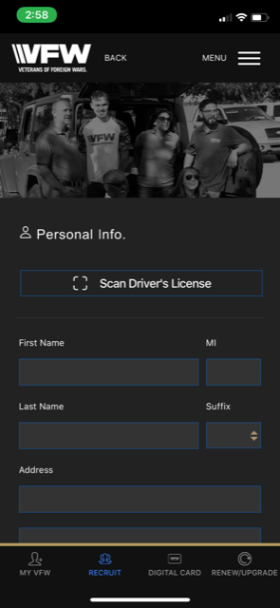
Additional Tools and Information (Cont.)
In 2020, we launched a new mobile recruiting form that will allow VFW members to recruit a new member for the Department based on their address.
In this form, we included new features to modernize the experience and enable a faster experience to collect data. These features include the use of Credit Card and Driver’s License scanning (making info easy to gather), clickable graphics of medals and campaigns, and a multi-step process to organize data collection in a wizard format. The Post QM gets a notification before the member is in the Post officially.

Slide 48
Additional Tools and Information (Cont.)
New Facebook Page: https://www.facebook.com/VFWmembershipHQ

Slide 49
Setting goals and achieving success

Slide 50
Setting Goals and Achieving Success (Cont.)
All-American and All-State plans as a guide
Can help a Post achieve great success
We have checklists on www.vfwva.org to make it easier

Slide 51
Setting Goals and Achieving Success (Cont.)
All-American
There are several parts to the plan with some of them being ones you can accomplish while recruiting.
Doing things through the year make it easier to accomplish it all.
Make 100% plus 1 member
Partner with other groups at least twice
Post pictures on your Post’s Facebook account

Slide 52
Setting Goals and Achieving Success (Cont.)
Major changes are seen this year. This course does not cover it all as you will get informed in your regular SOI. You should read the plan in depth to learn more about it. The plan is on the State HQs website, www.vfwva.org, and is available now.

Slide 53
Setting Goals and Achieving Success (Cont.)
All-State program requirements for Virginia point in one direction
Our overall goal is to STRENGTHEN membership and program participation
For membership that means…
More Lifetime Members
More Annual Members converting to be Lifetime Members
Stronger rates of Annual Members renewing
More Legacy Lifetime Memberships

Slide 54
Setting Goals and Achieving Success (Cont.)
The benchmarks for statewide membership though the year are:
September 15, 2021: 75%
December 30, 2021: 90%
March 30, 2022: 95%
May 9, 2022: 100%
June 30,2022: 105%

Slide 55
Incentives and Special Awards

Slide 56
Incentives and Special Awards
There are several trips from National HQs for recruiting
The include:
The D.C. Legislative Conference
Kansas City (National HQs)
National Convention
See the All-American plan for more details

Slide 57
Incentives and Special Awards
There are several other awards from National HQs for recruiting
They include:
Lapel pins for recruiting 5,10, and 15 members
CIC coin and citation for recruiting 25 members
VFW CIC Backpack at 50 members
Medallion set for 75 members
Century Recruiter Cap or VFW Store credit for 100 members
$250 VFW Store credit or 150 members

Slide 58
Incentives and Special Awards
Legacy Life Membership Award
When Posts have 25, 50, and 75 Legacy Life Members, they receive a special proclamation.
Post with 100 Legacy Life Members by July 1, 2022 receive a special proclamation and the Post receives a $1,000 stipend to attend the National Convention for either the Post Commander or a Post representative.

Slide 59
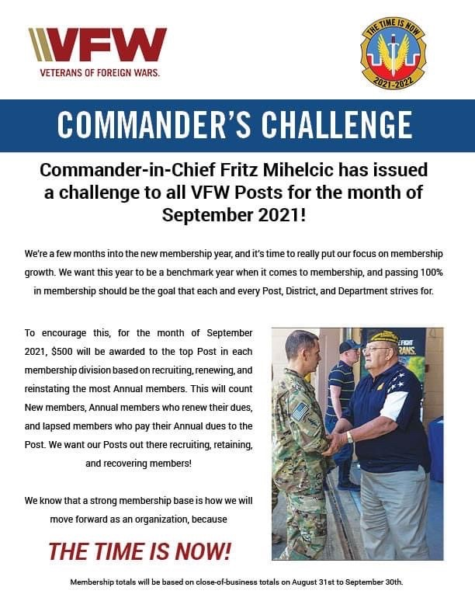
Incentives and Special Awards

Slide 60
State awards for Posts
Several awards are based on your Virginia membership categories (different from All-American membership divisions)
Category A: 10-75 members
Category B: 76-150 members
Category C: 151-250 members
Category D: 251-500 members
Category E: 501 or more members

Slide 61
State awards for Posts (Cont.)
Posts, in each category, may win the following...
Plaque for the Post with the largest numeric increase as of May 13, 2022
$200 to the Post with the largest increase in Lifetime Membership (minimum of 3 members) as of May 13, 2022
Plaque for Posts who renew all annual members (showing 100% retention on the National MEMSTATS report) by May 13, 2022

Slide 62
State awards for Posts (Cont.)
Posts, in each category, may win the following…
4) Lifetime Membership Drawings: 4 drawings for an annual member in the Post to become a Lifetime Member based on the membership as follows:
September 24, 2021 for Posts who achieve at least 75% by that date
October 29, 2021 for Posts who achieve at least 85% by that date
January 28, 2022 for Posts who achieve at least 95% by that date
March 25, 2022 for Posts who achieve at least 100% by that date

Slide 63
State awards for Posts (Cont.)
Posts, in each category, may win the following...
5) Post Commander and Quartermaster receive pins and coffee mugs if the Post
make 100% by May 13, 2022
6) $200 to the Post with the largest increase in Legacy Life Membership as of
May 13, 2022

Slide 64
State awards for individuals
Individuals may win the following awards:
Annual members who recruit at least 5 members get a portion of your dues reimbursed and your name in a drawing for a lifetime membership
Lifetime members who recruit at least 5 members are entered into a Legacy Lifetime Membership raffle for a one-step promotion (or $200 if already a Gold Legacy Lifetime Member)
All members who recruit at least 5 members are entered into a drawing for a trip to attend the National Convention (airfare/mileage & stipend).

Slide 65
State awards for individuals (Cont.)
Individuals may win the following awards:
“Recruiter of the Year” gets $300 to attend the state convention, a special VFW cap, a nametag, and a citation
Additional awards at the following levels:
20 Members: Pen and keychain set
25 Members: State Commander’s Challenger Coin
50 Members: Special VFW cap and citation
75 Members: State Commander’s jacket

Slide 66
Membership Is Here To Help

Slide 67
Membership/Life Membership Committee:
Chairman Tom W. Hines (434) 774-7729 membership@vfwva.org | Geoff Lyster (703) 725-7862 srvicecdr@vfwva.org | Mark Shockley (757) 377-3467 adjdist1@vfwva.org
Ken Wiseman (540) 487-4476 kwiseman@vfwva.org | Kathy Goodall (757) 572-8224 skckagret@yahoo.com | Mike Diaz (860) 514-5268 cdrdiaz7@vfwva.org
 | George Winters (703) 728-1520 cdrpost12179@vfwva.org

Slide 68
Questions?

